Slide 1


Online Quiz
By.
Trupti Patil
Rishabh Tiwari
Chirag Kumar
Date.08-08-2022

Slide 2
Introduction
Our aim is to develop an application for the users in which a user can attempt any number of quiz related to his/her choice”
We have to make interface .
These all pages have connectivity with the server and database

Slide 3
Approach
In this application firstly the user need to register or login using user-id and password.
Then the user can choose any of the quiz of his/her choice.
User can start attaining the quiz.
User can check his/her answers are right or wrong
After completion of the quiz user will get credit score for each of its correct answers.

Slide 4
Learnings
Database : MYSQL
RESTAPI : JAVA, Spring boot
Front-end : Angular
UI design : Material angular
For alerts : Sweet alerts and Snack bars

Slide 5
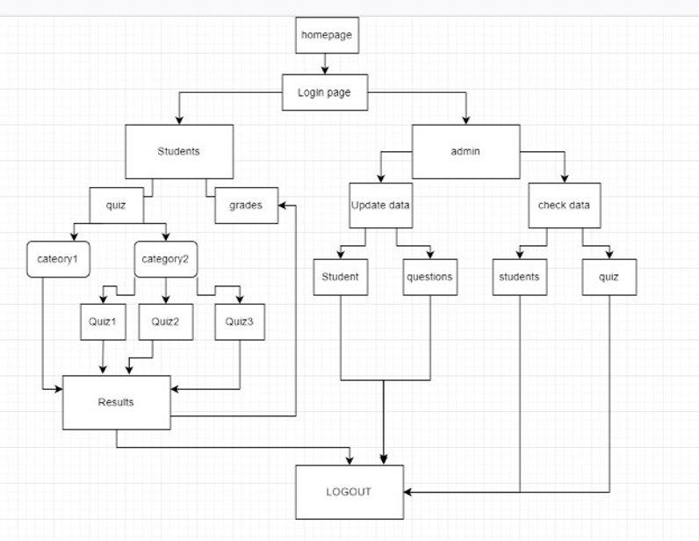
Flow Chart

Slide 6
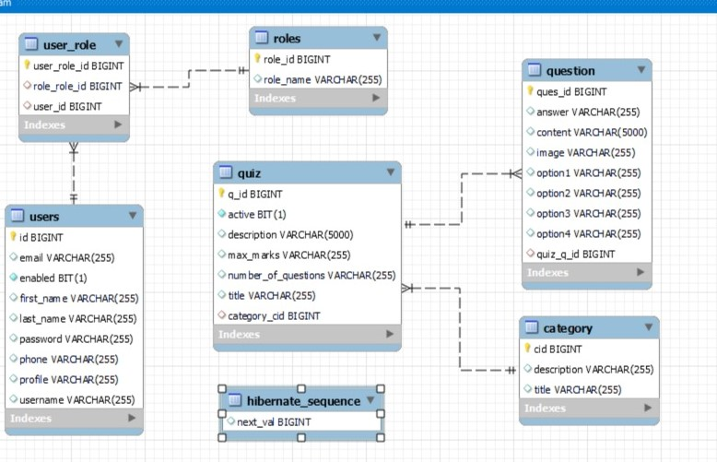
Database Architecture

Slide 7
Challenges Implemented
To give the user a proper role
Encryption of password
Displaying the results after attempting the quiz.

Slide 8
Technology
Spring boot
Angular
Java
My sql database

Slide 9
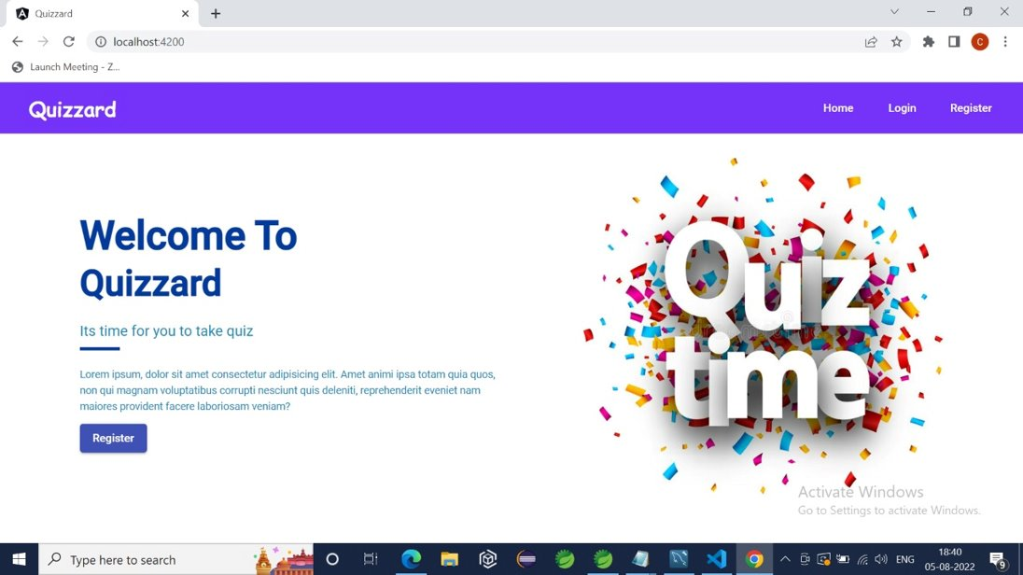
Welcome page

Slide 10
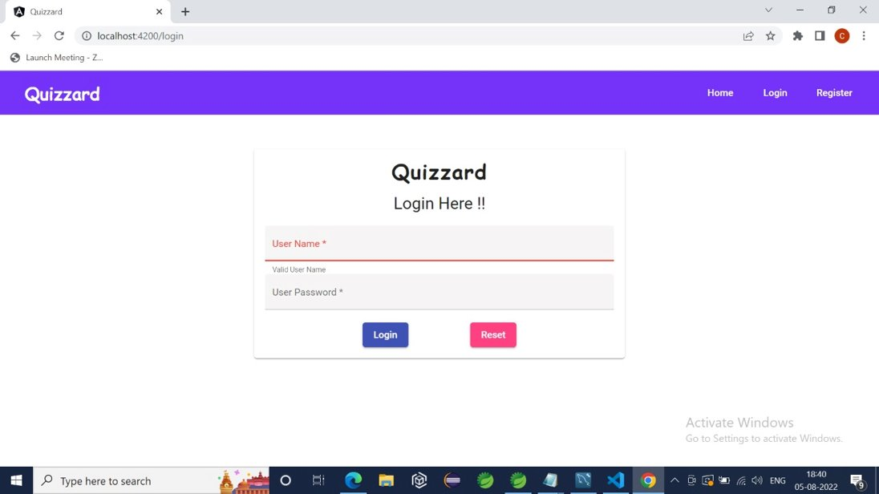
LogIn

Slide 11
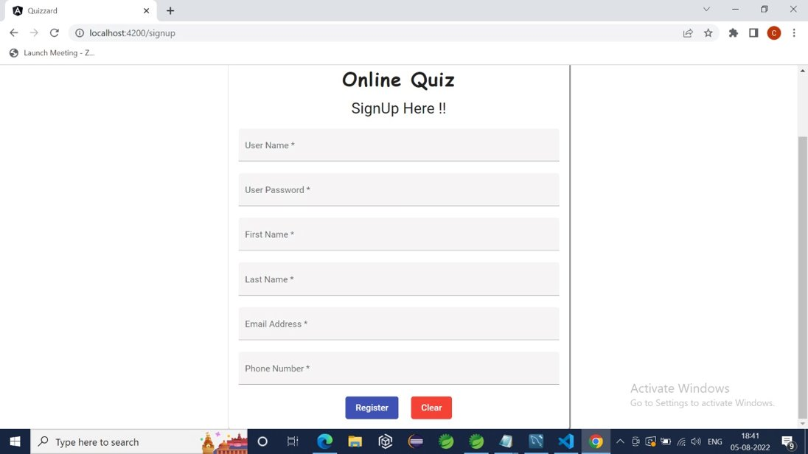
SignUp

Slide 12
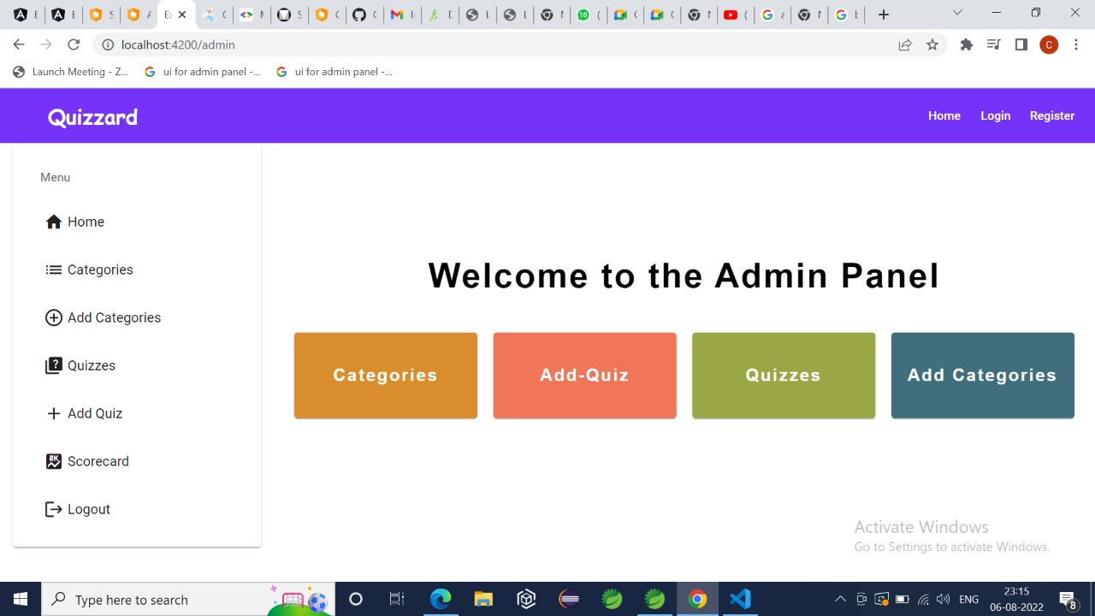
Admin Panel

Slide 13
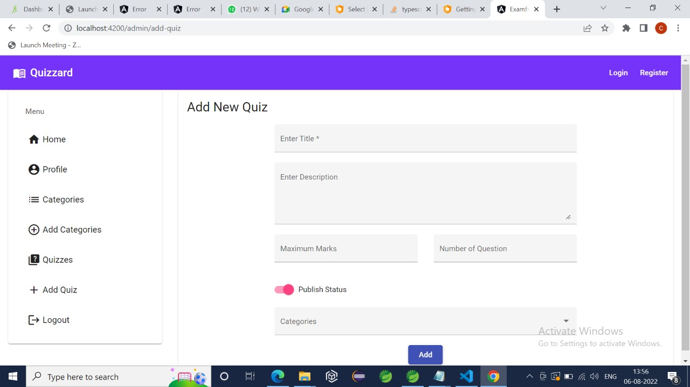
Add New Quiz

Slide 14
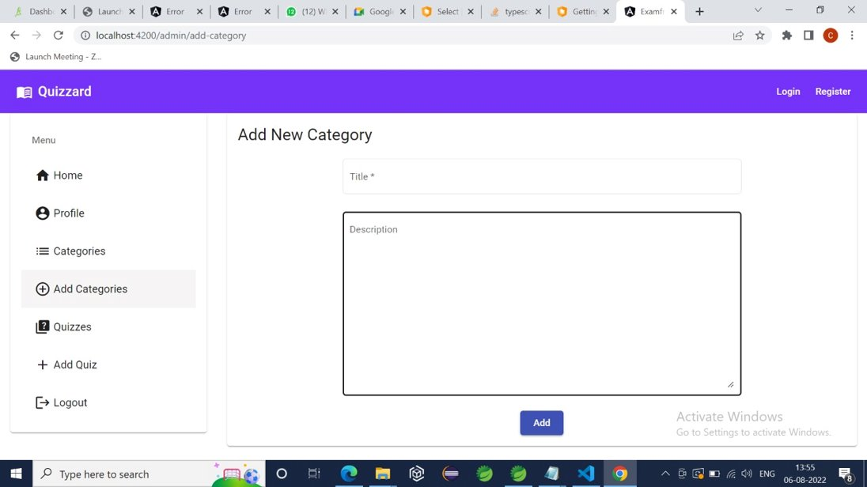
Add New Category

Slide 15
THANK YOU

